Slide 1
Predicting customer buying behaviour
Lívia de Souza Simões

Slide 2
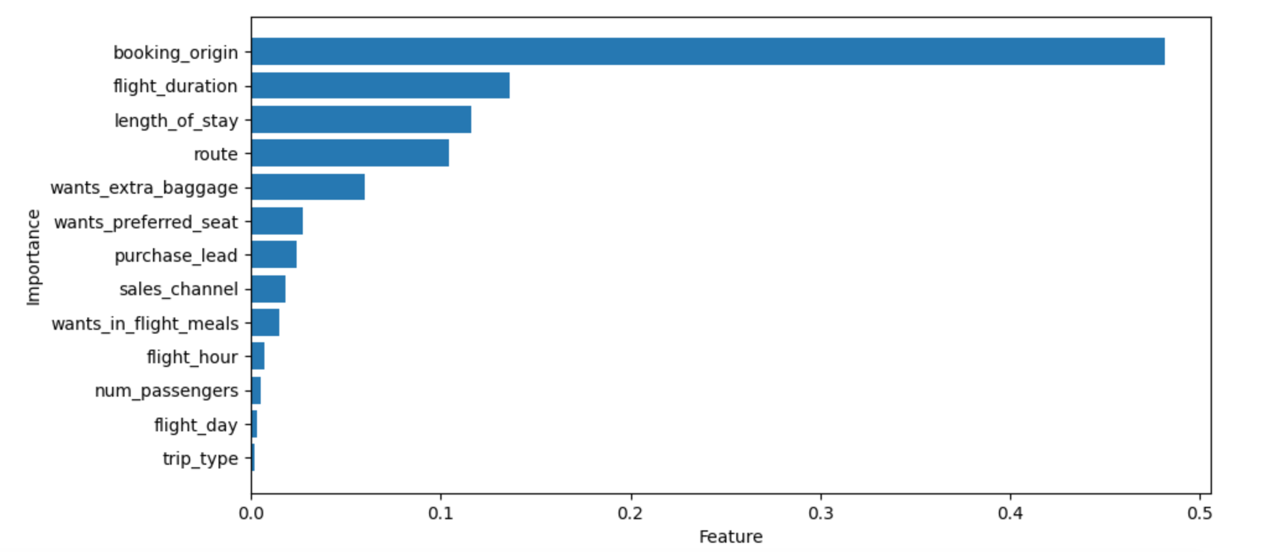
Features in descending order which influence Customer buying behavior
We have trained a Random Forest Classifier Model
Cross Validation with GridSearchCV
n_estimators = 100
max_depth=5
TOP 5 features which influence Customer buying behavior
booking_orgin
2. flight_duration
length_of_stay
Route
wants_extra_baggage
ACCURACY: 84.55%
AUC score: 0.5

